Slide 1
HealthHack
Krupal Patel
ENSE405
Activity#3

Slide 2

UN SD goal

Slide 3
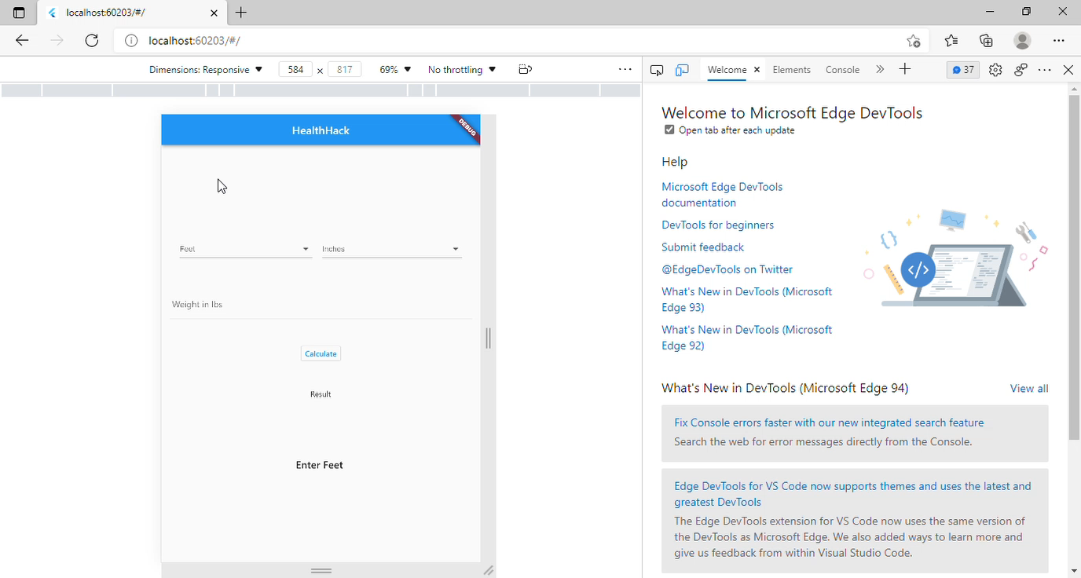
Demo

Slide 4
Thanks

